Slide 1
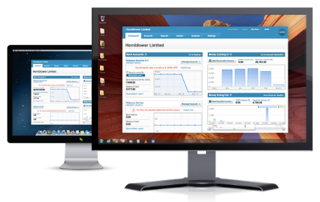





Asynchronous Web Services
Writing Asynchronous
Web Services
Web Services & Cloud
SoftUni Team
Technical Trainers
Software University
http://softuni.bg

Slide 2

Table of Contents
ASP.NET Thread Pool
Synchronous Model
Asynchronous Model
Asynchronous Actions
async and await

Slide 3

ASP.NET Thread Pool

Slide 4


ASP.NET Thread Pool
ASP.NET has a dedicated thread pool for servicing requests
Each request is granted its own thread to execute on
After the request is serviced, the thread returns to the thread pool and is ready to process a new request
Thread Pool
ASP.NET
HTTP
Server
Requests

Slide 5


Thread Starvation
A large number of requests can cause thread starvation
Not enough threads from the thread pool to service all requests
Requests queue up and wait for a thread to become available

Slide 6
Synchronous Actions
The servicing thread mostly "waits" for something to happen
E.g. database query result, hard-disk read, network response, etc.
During this time it does no actual work
public IHttpActionResult GetAllAds(
[FromUri]GetAdsBindingModel model)
{
...
var data = this.Context.Ads
.OrderByDescending(ad => ad.Name)
.Skip(page * model.Number)
.Take(model.Number)
.Select(ad => ad.Name)
.ToList();
return this.Ok(data);
}
Thread is blocked until the database returns the result

Slide 7

Asynchronous Model
The thread leaves a request whenever long waiting is possible
Services other requests during this time
Returns when the waiting is over

Slide 8
Asynchronous Actions
.NET 4.5 makes it very easy to write asynchronous actions
Method is marked async
Return type is wrapped in a Task<>
Blocking operation is await-ed
public async Task<IHttpActionResult> GetAllAdsAsync(
[FromUri]GetAdsBindingModel model)
{
...
var data = await this.Context.Ads
.OrderByDescending(ad => ad.Name)
.Skip(page * model.Number)
.Take(model.Number)
.Select(ad => ad.Name)
.ToListAsync();
return this.Ok(data);
}
Thread is freed until the *Async() method returns a result

Slide 9
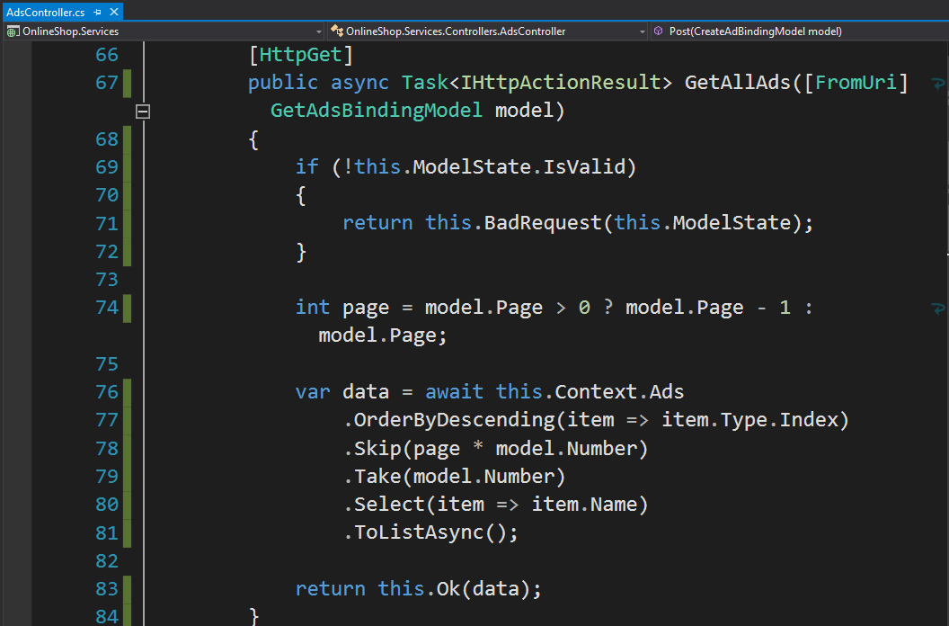



Asynchronous Actions
Live Demo

Slide 10









Asynchronous Web Services
https://softuni.bg/courses/web-services-and-cloud/

Slide 11
License
This course (slides, examples, demos, videos, homework, etc.) is licensed under the "Creative Commons Attribution-NonCommercial-ShareAlike 4.0 International" license
Attribution: this work may contain portions from
"Web Services and Cloud" course by Telerik Academy under CC-BY-NC-SA license

Slide 12






Free Trainings @ Software University
Software University Foundation – softuni.org
Software University – High-Quality Education, Profession and Job for Software Developers
softuni.bg
Software University @ Facebook
facebook.com/SoftwareUniversity
Software University @ YouTube
youtube.com/SoftwareUniversity
Software University Forums – forum.softuni.bg

